Slide 1
CTS 6319 Cyber Security: Measurement and Data Analysis
Dr. Elias Bou-Harb
ebouharb@fau.edu EE 503B
Office hours: Mondays 4-6pm

Slide 2
Material
On Canvas
Research Paper 2:
A Survey of Defense Mechanisms Against Distributed Denial of Service (DDoS) Flooding Attacks

Slide 3
Denial of Service Attacks
DoS attacks are explicit (and malicious) attempts to prevent the legitimate use of a service
Damage (mostly financial) to the entity under attack
Collateral damage to the infrastructure (routers, links, etc.)
Ruined reputation and trust
According to Arbor Networks, there are around 5000 DoS attacks per day

Slide 4
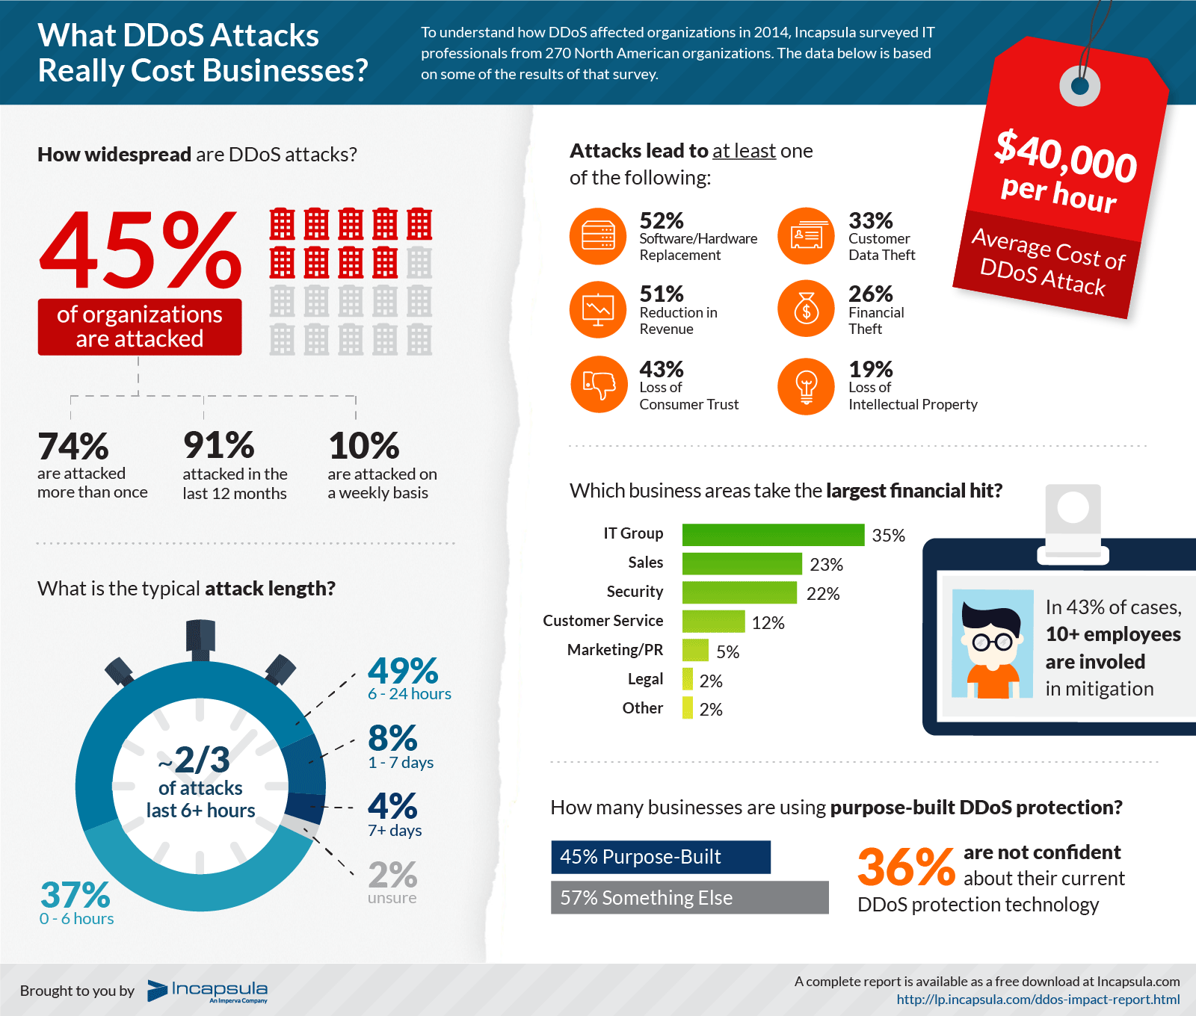

Slide 5
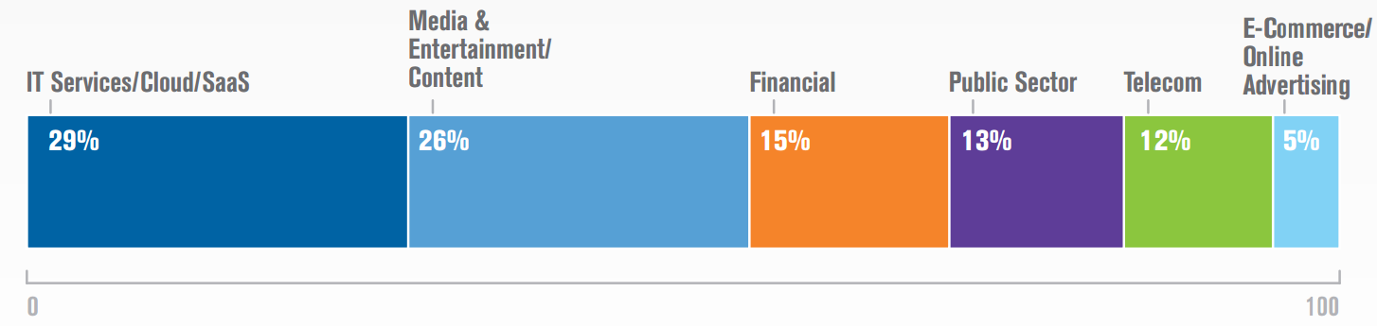
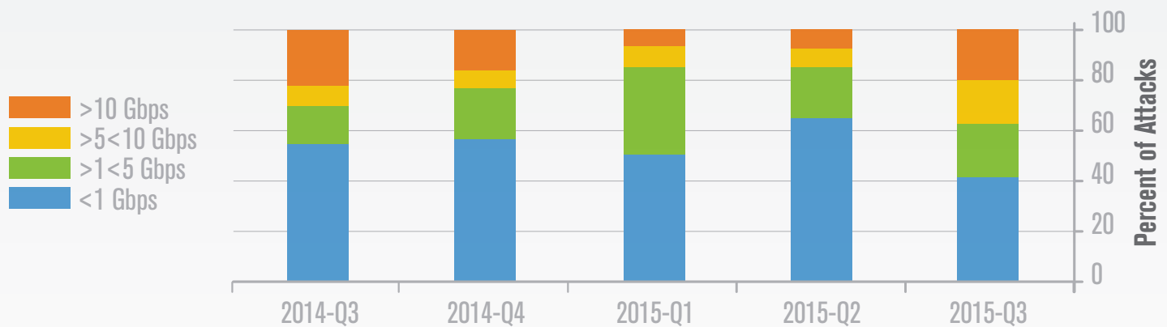
Denial of Service Attacks

Slide 6
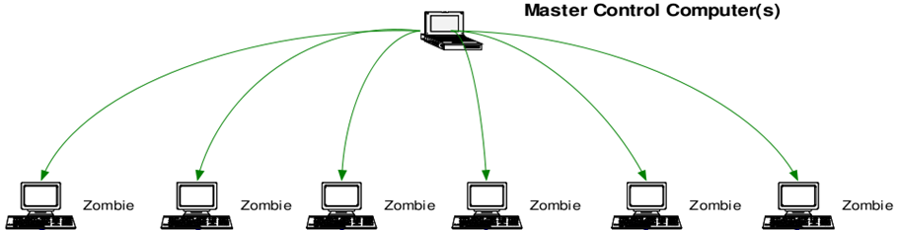
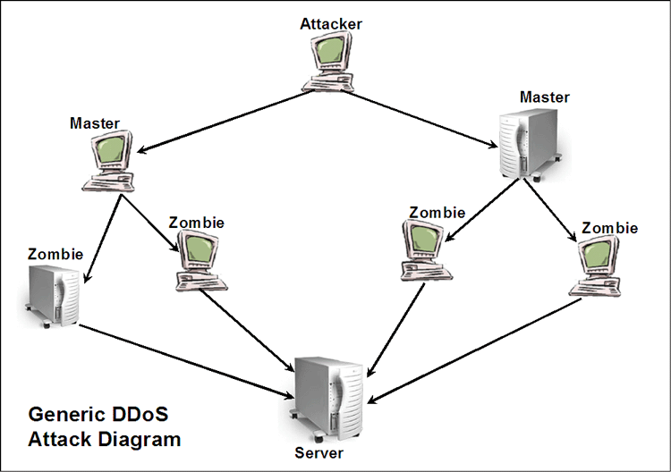
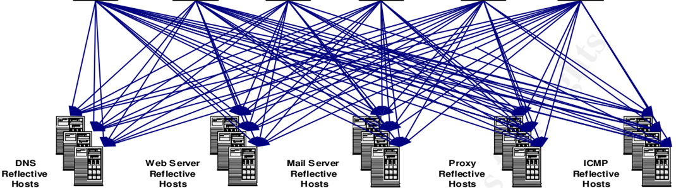

Distributed Denial of Service (DDoS) Attacks

Slide 7
Taxonomy of DDoS
Attack Techniques & Defense Mechanisms
Attack Techniques
Flooding Attacks
Reflection/Amplification Attacks
Defense Mechanisms
- Attack Prevention and Mitigation - Attack Detection - Attack Attribution
TCP SYN, UDP, ICMP, DNS, HTTP, SIP, etc.
NTP, DNS, SNMP, SSDP, CharGen, QOTD, Quake 3, NetBios, RIP, etc.

Slide 8
DDoS Flooding Attacks
TCP Flooding
Attacker spoofs its IP address and sends a flood of TCP SYN packets (with different destination ports) to target
Target send SYN/ACK to spoofed address waiting for ACK
ACK never comes back and server ends-up wasting resources and eventually crashing
ICMP Flooding
Attacker spoofs its IP address replacing it by IP address of target
Attacker sends ICMP Echo packet to as many hosts as possible
Hosts reply to target by flood of ICMP Echo replies

Slide 9
DDoS Flooding Attacks
UDP Flooding
Attacker spoofs its IP address and sends a flood of UDP packets to random ports on target
Target system will look for service application on that port, but eventually replies by ICMP Destination Unreachable
Attacker repeats the flood until target is down
DDoS Flooding attacks overwhelm their targets so either their systems, applications, bandwidth, or any other resources are completely occupied, causing the targets to crash or significantly decrease their performance throughput.

Slide 10
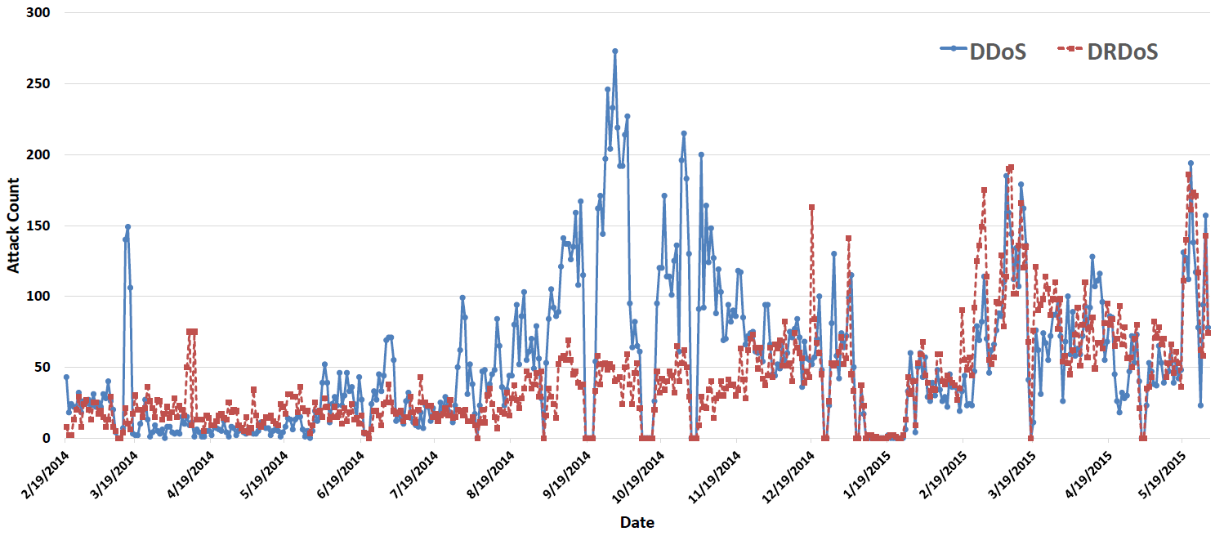
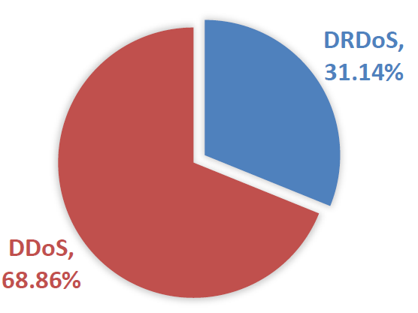
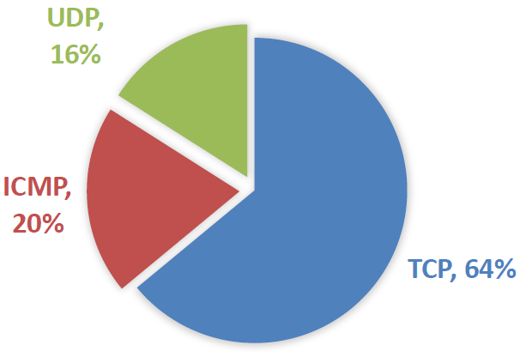
DDoS Flooding Attacks

Slide 11
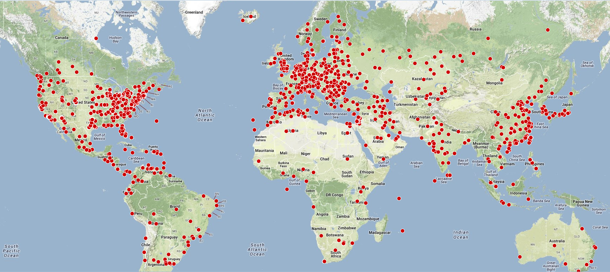
DDoS Flooding Attacks
Daily tens of thousands of threats

Slide 12
Considerations of DDoS Detection
Defense strength
Compromise resiliency
Delay in detection/mitigation
Performance
Type (passive, proactive)
Implementation complexity
Usability
Deployment
Scalability

Slide 13
Metrics of Defense Strength
True Positive (TP): An attack that was successfully detected
False Positive (FP): A benign activity that was incorrectly detected as an attack
True Negative (TN): A benign activity that was correctly detected
False Negative (FN): An attack that was incorrectly detected as benign activity

Slide 14
Metrics of Defense Strength
Accuracy= (TP+TN)/(TP+TN+FP+FN)
False Negative Rate=FN/(TN+FN)
False Positive Rate=FP/(TP+FP)
Precision=TP/(TP+FP)

Slide 15
A numerical example
A DDoS detection engine investigated 1000 traffic sessions. Given that 10% of those traffic sessions are DDoS activities (ground truth), and knowing that the engine inferred 20% as being related to DDoS activities, what is the accuracy of the engine?

Slide 16
DDoS Flooding Attacks-Situational Awareness
DDoS Attacks
Detection Deployment Architectures
Situational Awareness
Source-based
Destination-Based
Network-Based
Prevention
Characterization
Response

Slide 17
DDoS Flooding Attack Detection
Statistical
Data mining (classification)
Protocol-based

Slide 18

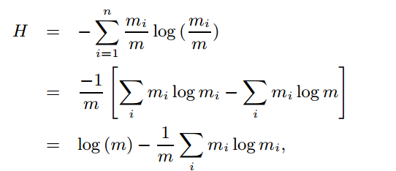
DDoS Flooding Attack Detection
Statistical
Entropy-based
f-divergence
Kolmogorov–Smirnov test
http://ieeexplore.ieee.org/xpls/abs_all.jsp?arnumber=5546587&tag=1
http://www.sciencedirect.com/science/article/pii/S0140366412001156
http://ieeexplore.ieee.org/xpls/abs_all.jsp?arnumber=1194894

Slide 19
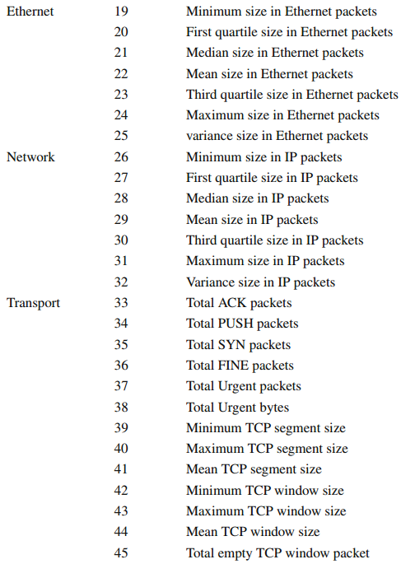
DDoS Flooding Attack Detection
Data mining (classification)
Traffic features
Training
Testing (Support Vector Machines, K-means, Expectation Maximization)

Slide 20
CTS 6319 Cyber Security: Measurement and Data Analysis
Dr. Elias Bou-Harb
ebouharb@fau.edu EE 503B
Office hours: Mondays 4-6pm
http://faculty.eng.fau.edu/ebouharb/

